Slide 1
An Analysis of Sports Data and Performance in the NBA
(The Knicks Suck)
Adithya Venkatesh
Darryl Baynes
Patrick Hennessey
Notes:
An analysis of sports data and Performance in the NBA, presented by Adithya Venkatesh, Darryl Baynes, and Patrick Hennessey

Slide 2
Motivation
A love of sports
Familiarize ourselves with sports data
Attempt to use data as a means to improve a players performance
Notes:
Motivations.
This project was born from a love of sports that we all shared
When coming up with this project we wanted to get an opportunity to work with sports data and see if we could convert that data into actionable strategies to help players improve their game.

Slide 3
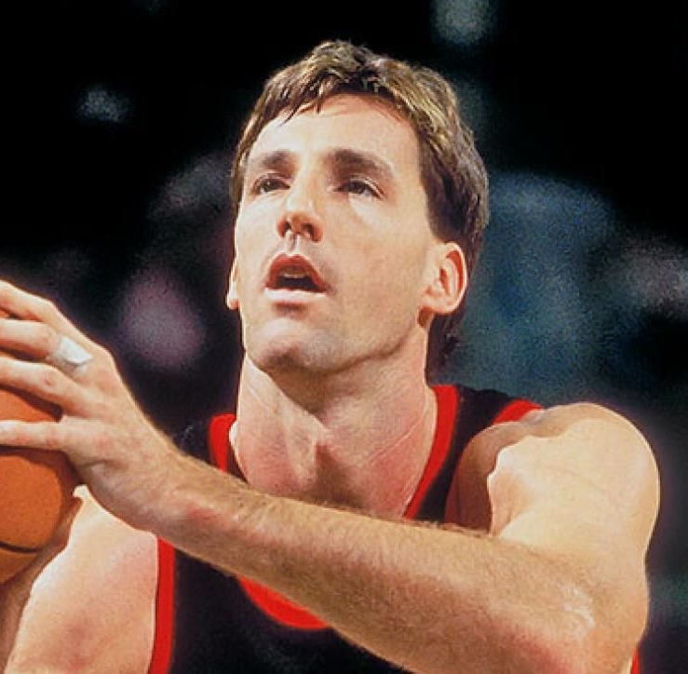
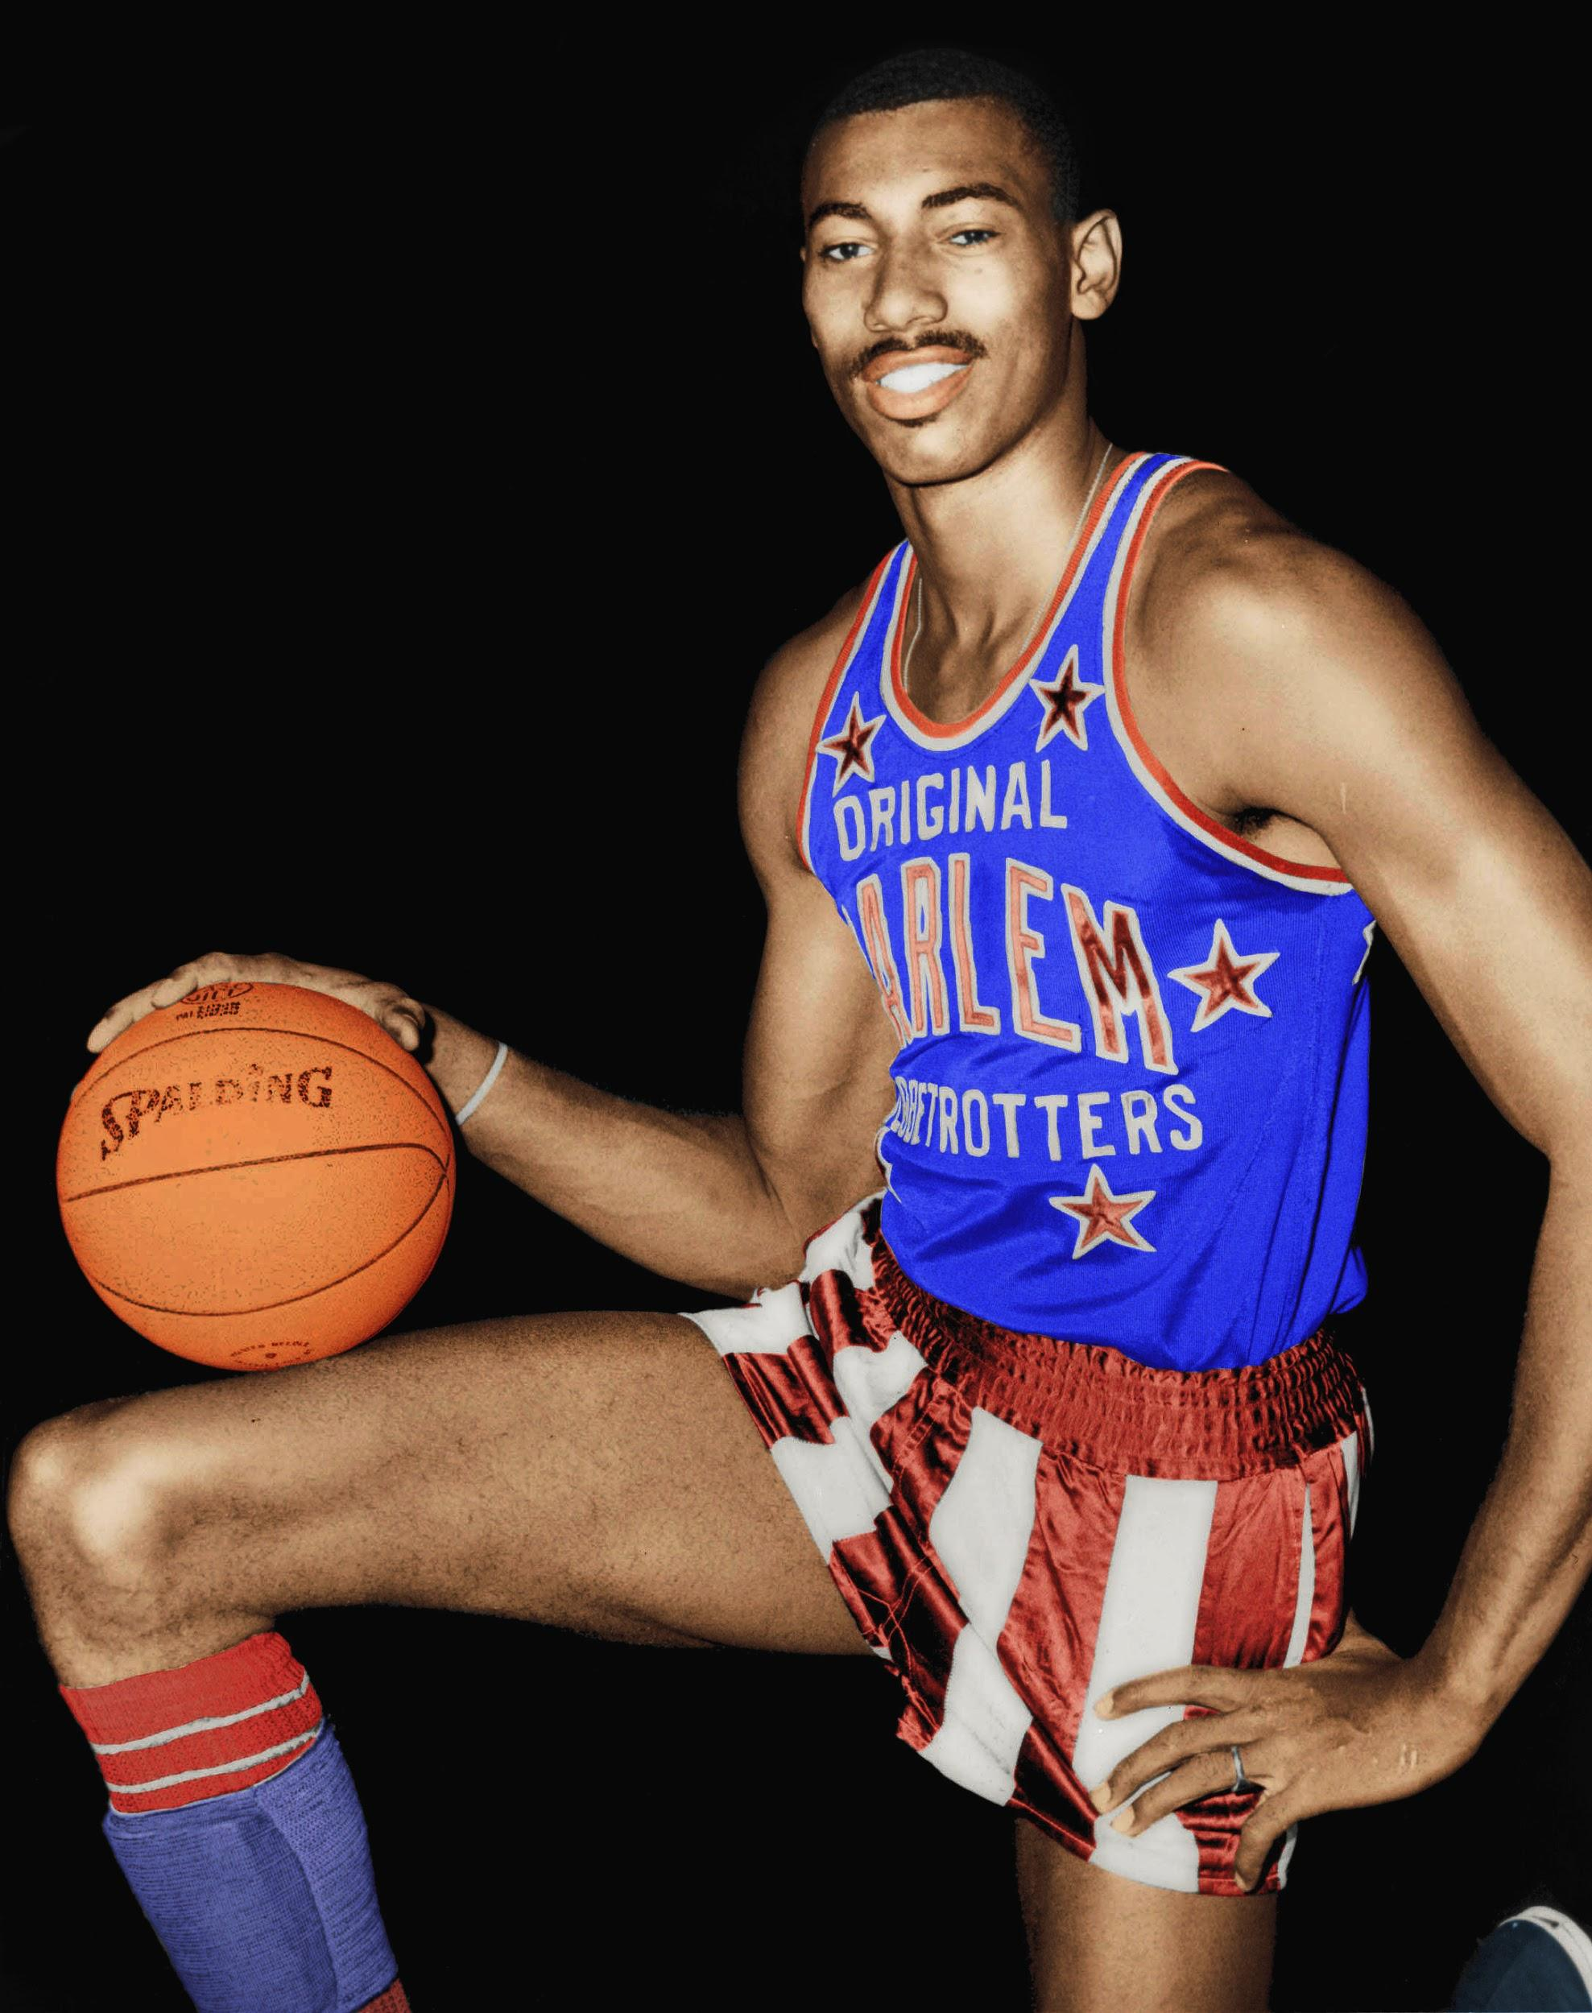
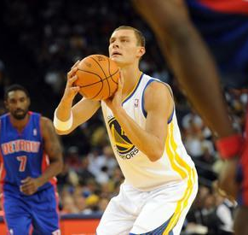
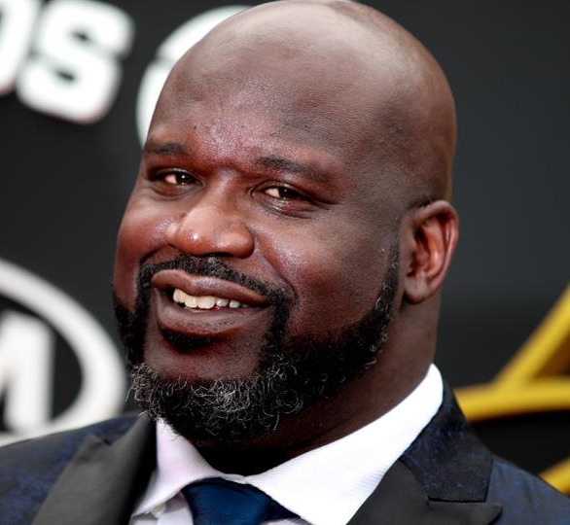
Initial Questions
Who are the worst free throw shooters?
Are these players scoring potential being hindered by their size?
How could they improve?
Chris Dudley: 45.8% Wilt Chamberlain: 51.1% Andris Bieddrins: 51.1% Shaquille O'Neal: 52.7%
Notes:
At the beginning of the project we started off asking who are worst Free Throw shooters in the NBA.
Below are some of the worst free throw shooters the league has ever seen and while looking these players up we noticed a trend...They’re exceptionally tall, even for an NBA player. Many are no shorter than 6’11”.We began to wonder if their height is actually hindering their performance.

Slide 4
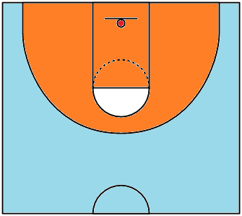
Question
3P
Is there a correlation between physical attributes (height, wingspan, ratio) and scoring percentage (FT%, 2P%, 3P%)
3P
3P
2P
2P
3P
FT
2P
2P
2P
3P
3P
3P
Notes:
After thinking through these initial questions we decided on the following question
Is there a correlation between physical attributes (height, wingspan, ratio) and scoring percentage (FT%, 2P%, 3P%) ***Explain

Slide 5
Hypothesis
Players with more height have a lower free throw percentage
Players with more height do not take as many shots from distance
Players with a longer wingspan have a higher scoring percentage regardless of location
Players with longer wingspans have the arm length to shoot over their lesser wingspan opponent
Notes:
So with that question in mind we came up with our hypothesis’
Players with more height have a lower free throw percentage
Players with more height do not take as many shots from distance
Players with a longer wingspan have a higher scoring percentage regardless of location
Players with longer wingspans have an advantage under the basket but also have the arm length to shoot over their opponent

Slide 6

Data Cleanup & Exploration
Sources:
NBA.com (2003-2019 combine metrics CSV)
Basketball-Reference (2019-2020 NBA player performance CSV)
Insights:
Found that taller people took fewer 3PA and averaged the same as the average NBA player.
A longer wingspan was more likely to indicate a worse 3P% than height would
Notes:
*Go over issues and how we solved

Slide 7
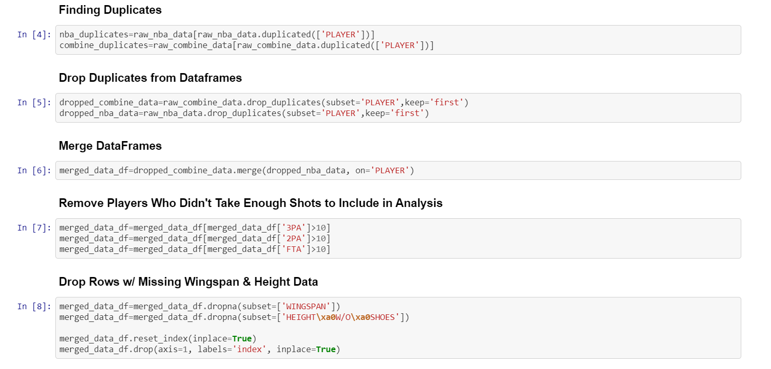
Code/ Issues
Notes:
Merged data on each player for the season
Shot attempts per shot category
Drop na and duplicates for wingspan and height (multiple individuals traded during seasons so accounted for total individual players stats)

Slide 8
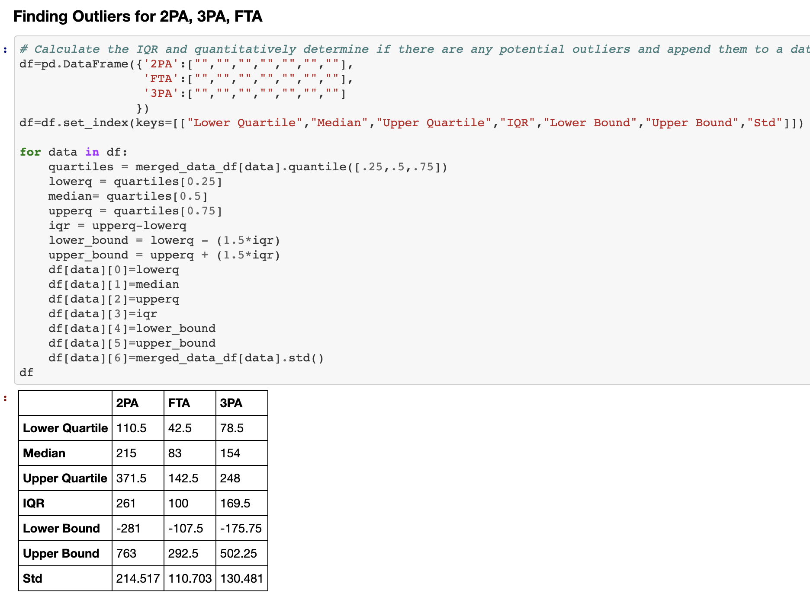
Code
Notes:
IQR was created to find outliers and assist in filtering out unnecessary data. (Large STDV and Negative lower bound) safe to go with 10 attempted shots per shot category.

Slide 9
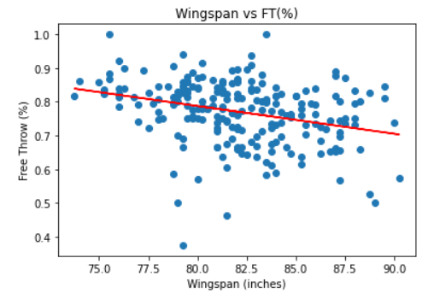
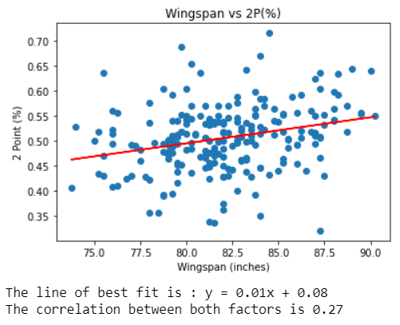
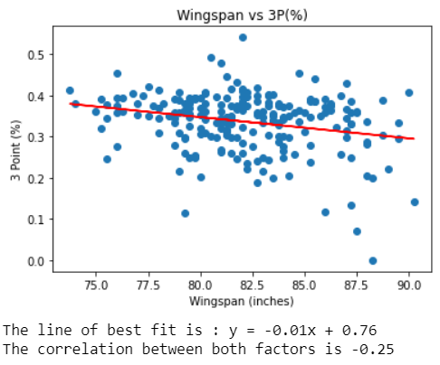
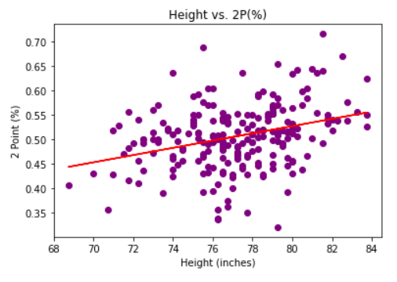
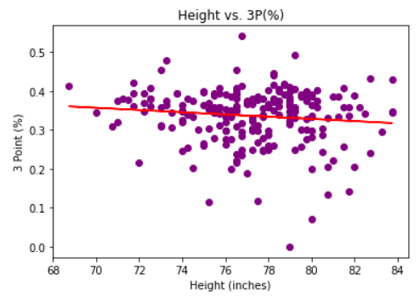
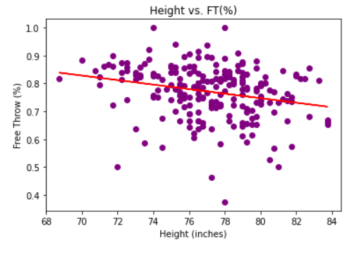
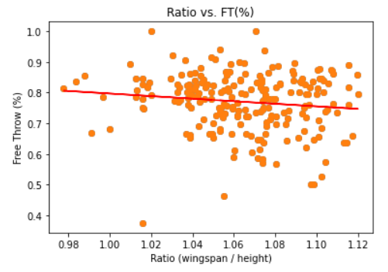
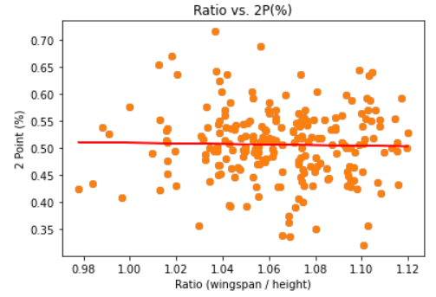
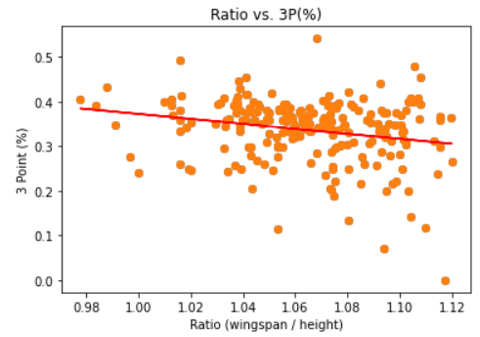
Data Analysis
Notes:
#2 FT/3P% why negative correlation as height increases and positive correlation as height increases for 2P%: Reason #1: Dunks and layups are high success rate shots thereby explaining high % 2P% shot Reason #2: There’s still a ton of area on the basketball court that is a 2P shot, example step inside 3P range = difficult shot and only worth 2P ***
Reason #3: Negative corr between FT% and 3P% (Taller players have less experience shooting from a distance) because they predominantly play under the basket (Layups and dunks) ***
Reason #4: Ratio to account for any major diff but instead weak correlation

Slide 10
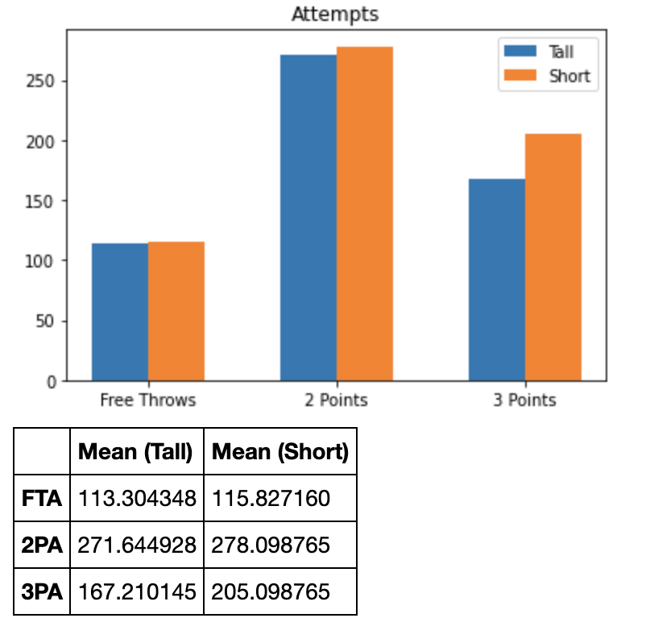
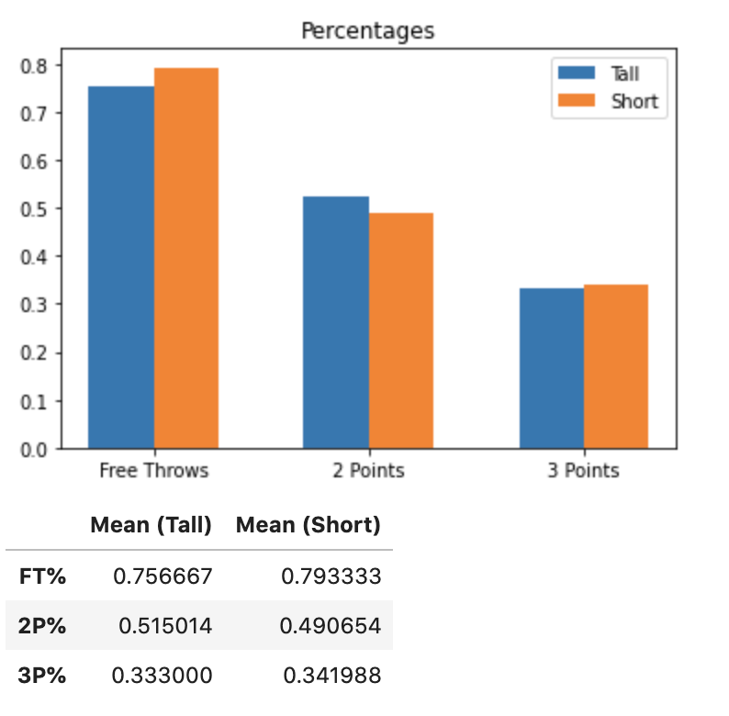
Data Analysis
Tall <= 77.50” or 6’ 4.50”
Short > 77.50” or 6’ 4.50”
Notes:
Found minimum height for PF and C and min height for current season PF is 77.50 inches or 6’4 and above is tall
Percentages and attempts were all same in every shot category except 3 points
3 points

Slide 11
Discussion
Expected Outcome: Negative correlation between height and FT% (-0.25).
Unexpected Outcome: Negative correlation between wingspan and FT% (-0.30).
Unexpected Outcome: Negative correlation between wingspan and 3P% (-0.25).
Notes:
Show graph

Slide 12
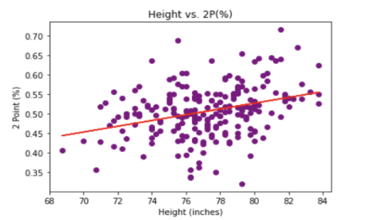
Conclusion
“Taller” NBA players should avoid taking shots where they are likely to be fouled and have to attempt a FT. “Taller” NBA players capability to attain a higher 3P% and therefore should have a higher number of 3PA.
Satisfied - Taller players have a higher 2P%. Non-Satisfaction - Deviation in Height vs. 2P% graph.

Slide 13
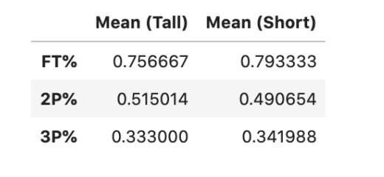
Post Mortem
What would you research next?
Focus on collegiate FT% and 3P % relationship? Why do “Shorter” players have a greater efficiency when shooting? Should “Taller” players take more 3PA? Comparing taller and shorter players who should ideally take more shots at each range?
Notes:
Point #2: More attempts = greater efficiency in long run?
Point #3 Strategy: If they took more their percentages may increase as the trend suggests.

Slide 14
Questions?

Slide 15
GitHub Repo

Slide 16
Correlation Values (Go over 1 per slide)
---------------Height Correlation-------------
The correlation between Height and 2P% is 0.32
The correlation between Height and 3P% is -0.12
The correlation between Height and FT% is -0.25

Slide 17
Correlation Values
---------------Wingspan Correlation-------------
The correlation between Wingspan and 2P% is 0.27
The correlation between Wingspan and 3P% is -0.25
The correlation between Wingspan and FT% is -0.3
Wingspan might be a greater indicator of individual defensive prowess instead of an offensive competitive advantage.

Slide 18
Correlation Values
---------------Ratio Correlation----------------
The correlation between Ratio and 2P% is -0.02
The correlation between Ratio and 3P% is -0.22
The correlation between Ratio and FT% is -0.13
A FT is set and a jump shot from open play from the free throw line is more similar to shooting a three point shot in terms of difficulty for taller players with larger wingspans.

Slide 19
Correlation Values
------------------2PA Correlation----------------
The correlation between 2PA and 2P% is 0.11
The correlation between 2PA and 3P% is 0.05
The correlation between 2PA and FT% is 0.2

Slide 20
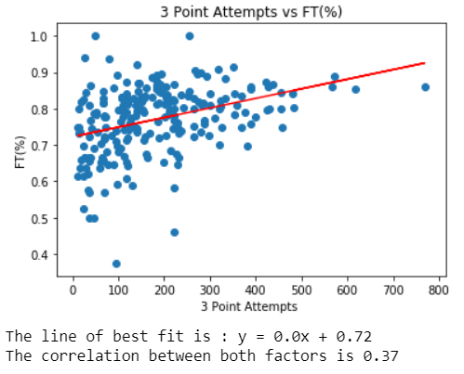
Correlation Values
------------------3PA Correlation----------------
The correlation between 3PA and 2P% is -0.03
The correlation between 3PA and 3P% is 0.42
The correlation between 3PA and FT% is 0.37
3PA vs FT% unblocked shots
FT% oddities: Steph Curry 5 games played Tony Snell 32 for 32

Slide 21
Correlation Values
------------------FTA & FT% Correlation----------------
The correlation between FTA and 2P% is 0.12
The correlation between FTA and 3P% is 0.02
The correlation between FTA and FT% is 0.24
The correlation between FT% and 3P% is 0.34

